Slide 1
Background Screening
A state of Florida Enterprise survey aimed at identifying Costs, and Opportunities for Efficiencies and Economies
Notes:
In 2012, the Executive Office of the Governor’s Chief Inspector General (CIG) and agency Offices of Inspectors General performed an Enterprise Risk Assessment and developed an Enterprise Project Plan. Due to the potential risks and opportunities for cost savings to the enterprise, the Background Screening topic was selected as a project.

Slide 2
Presentation Outline
Presentation content includes:
Objectives, Scope and Methodology
Background
Survey Results
Costs to Purchase and Maintain
Pros and Cons
Fingerprint Retention
Recommendations

Slide 3
Project objectives
Review applicable laws, rules and regulations regarding the background screening process;
Review prior audits related to background screenings to determine if further follow-up is needed;
Identify Livescan devices owned and operated for the purpose of screening State of Florida employees; and
Identify opportunities for improved efficiencies and economies related to the background screening process and use of Livescan devices.
Notes:
Reviewed prior audit reports related to background screening issued from AWI & DCF. Neither audit relates to the objectives of this project.

Slide 4
Project scope
The project scope was limited to those background screenings where the payment of the screening is the responsibility of the State of Florida - full-time equivalent (FTE) employees, other personal services (OPS) employees, contracted employees, sub-contracted employees, interns, students and volunteers.
The project covered both Level 1 and Level 2 background screenings, as defined in Section 435.03(1), Florida Statutes (F.S.).
Initial and renewal background screenings were examined.

Slide 5
Project methodology
Comprehensive online survey (24 Participants)
Quantity of devices owned by the State of Florida
Leveraging devices among city, county and state government entities
Memorandums of Understanding/Agreement
Average cost to purchase, setup, and maintain a Livescan device
Cost variances among private service providers
Owning a device vs. utilizing a service provider
Cost and benefits of retaining fingerprints
Notes:
A survey was distributed to all participating agencies to gather information on various aspects of their background screening process. The team then gathered the information obtained from the survey as well as other relevant information to:
- Identify the quantity of devices owned by the State of Florida;
- Determine if devices are leveraged and shared among city, county and state government entities to contain costs;
- Determine if there are agreements in place in instances of device leveraging;
- Determine the average cost for a state agency to purchase, setup, and maintain a device;
- Identify cost variances among private service providers;
- Evaluate the cost/savings of owning a device vs. utilizing a service provider; and
- Evaluate the cost and benefits of retaining fingerprints.

Slide 6
BACKGROUND

Slide 7
statutory references
Section 110.1127, F.S., establishes the criteria for conducting background screening as a condition for employment and continued employment.
  A Level 1 screening generally refers to a state only name based check and an employment history check.
All persons and employees in positions designated as special trust or responsibility must undergo employment screening using Level 2 screening standards.
  A Level 2 screening refers to a state and national fingerprint based check and consideration of disqualifying offenses.
Notes:
Section 110.1127, Florida Statutes (F.S.), establishes the criteria for conducting background screening as a condition for employment and continued employment. Each agency designates those positions that, based on the position duties, require background screening. All persons and employees in such positions must undergo employment screening in accordance with Chapter 435, F.S., using Level 1 screening standards, as a condition of employment and continued employment. Also, each agency shall designate those positions that because of the special trust or responsibility or sensitive location, require security background investigations. All persons and employees in such positions must undergo employment screening in accordance with Chapter 435, F.S., using Level 2 screening standards, including fingerprinting, as a condition of employment and continued employment."
Level 1 and Level 2 Background Checks are terms used in Florida Law to convey the method of the criminal history record check and the extent of the data searched. However, the terms may also refer to certain disqualifying offenses if certain statutes are referenced. Level 1 and Level 2 are terms that pertain only to Florida and are not used by the FBI or other states. They are defined in Chapter 435, F.S., but are used elsewhere in statute without definition and appear not to be associated with all provisions in the chapter.

Slide 8
Livescan devices
Livescan devices (hereby referred to as devices)are a type of equipment (not a brand) utilized to electronically capture and transmit fingerprints.
Livescan devices are used to roll and transmit fingerprints.
Agencies may operate their own devices, utilize service providers or any combination thereof.
Based upon changes made by the Federal Bureau of Investigation (FBI), the Florida Department of Law Enforcement (FDLE) now requires all fingerprints to be submitted electronically.
There is a list of FBI approved devices, as well as FDLE certification, test & registration requirements that must be passed in order to transmit fingerprints.
Notes:
FDLE does not charge fees to register and certify a device. However, there are several steps that must be completed.
-The device must successfully pass the FBI Certification process. In order to be certified, the device must be in compliance with the FBI’s Integrated Automated Fingerprint Identification System (IAFIS) Image Quality Specifications (IQS).
- A registration form must be submitted for each device.
The appropriate data must be submitted from each device into a test system and must pass validation routines administered by FDLE.
Accepted customers must submit individual registration forms provided by FDLE for each account they will be using.

Slide 9
FDLE Evaluated Service Providers/Vendors
The following website lists service providers and device vendors who have voluntarily chosen to have their device(s) and electronic fingerprint data submissions evaluated by FDLE to verify compliance with both FDLE and FBI regulations and standards:
  http://www.fdle.state.fl.us/Content/getdoc/941d4e90-131a-45ef-8af3-3c9d4efefd8e/Livescan-Service-Providers-and-Device-Vendors.aspx
    This website may also be easily located by searching “FDLE Livescan Service” in your web browser.

Slide 10
Sharing of criminal records
State agencies cannot exchange or share criminal records without prior approval from FDLE.
SHARING
Notes:
28 CFR 50.12 – Exchange of FBI identification records
“The Federal Bureau of Investigation, hereinafter referred to as the FBI, is authorized to expend funds for the exchange of identification records with officials of federally chartered or insured banking institutions to promote or maintain the security of those institutions and, if authorized by state statute and approved by the Director of the FBI…”
“The FBI Director is authorized by 28 CFR 0.85(j) to approve procedures relating to the exchange of identification records. Under this authority, effective September 6, 1990, the FBI Criminal Justice Information Services (CJIS) Division has made all data on identification records available for such purposes. Records obtained under this authority may be used solely for the purpose requested and cannot be disseminated outside the receiving departments, related agencies, or other authorized entities. Officials at the governmental institutions and other entities authorized to submit fingerprints and receive FBI identification records under this authority must notify the individuals fingerprinted that the fingerprints will be used to check the criminal history records of the FBI. The officials making the determination of suitability for licensing or employment shall provide the applicants the opportunity to complete, or challenge the accuracy of, the information contained in the FBI identification record...”

Slide 11
Care provider clearinghouse
Provides single data source for background screening results for positions that serve vulnerable persons.
In 2012, HB 943 provided authority through Section 435.12, F.S. [FBI Approved]
7 Authorized Florida State Agencies: AHCA, DOH, DVR, DOEA, DJJ, DCF, and APD.
Fingerprints retained for five years.
Fingerprints, photograph, and signed privacy policies are required for entry.
Notes:
The purpose of the Care Provider Background Screening Clearinghouse is to provide a single data source for background screening results of persons required to be screened by law for employment in positions that provide services to children, the elderly and disabled individuals (vulnerable persons).
The Clearinghouse allows results of criminal history checks to be shared among 7 specified agencies when a person has applied to volunteer, be employed, be licensed, or enter into a contact that requires a state and national fingerprint-based criminal history check.
The 7 Florida State Agencies authorized to participate in the Clearinghouse include:
1. Agency for Health Care Administration (AHCA)
2. Department of Health (DOH)
3. Division of Vocational Rehabilitation (DVR)
4. Department of Elder Affairs (DOEA)
5. Department of Juvenile Justice (DJJ)
6. Department of Children and Families (DCF)
7. Agency for Persons with Disabilities (APD)
The retention of fingerprints will allow the Florida Department of Law Enforcement (FDLE) to report any new arrest/registration information to the specified state agencies.

Slide 12
Background screening fees
There is a cost difference for submission of Level 1 screenings depending on the purpose of the request.
  Generally the cost for a Level 1 screening is $24, unless otherwise authorized by the Legislature.
  Submissions for criminal justice purposes do not have a fee.
There is a cost difference for submission of Level 2 screenings depending on the purpose of the request.
  Submissions for criminal justice purposes do not have a fee;
  The fee is $40.50 for most state agencies ($24 state fee + $16.50 federal fee).
    The cost for non-criminal justice requests covers the original submission and, if it is rejected, a second submission.
    If a second submission is rejected the agency is authorized to perform a name search with the FBI at no charge.
    Payment terms to FDLE must be agreed upon between the state agency and a service provider. FDLE will charge the device owner.
Notes:
Some agencies such as Agriculture and Children & Families have reduced state fees stipulated in statute for certain individuals.

Slide 13
SURVEY RESULTS

Slide 14
Device utilization & leveraging
For the purposes of this project, service providers may be another state agency, a private entity or a non-state entity whose devices may be leveraged to capture and transmit fingerprints.
Private service providers capture and transmit fingerprints generally for a profit.
  Research indicates that private service provider fees range from $39.50 to $85.00. (Average $57.37)
  Half of the agencies who participated in the survey indicate they use private service providers.
Non-state entities may offer fingerprint capture and transmission either for profit or free of charge. These entities include other governmental entities such as:
  Local Law Enforcement
  Other City Governmental Entity
  Other County Governmental Entity
In every county where State owned devices are located, at least 1 agency still uses a private service provider.
  For example, even though there are 21 State owned devices in Leon County, 4 agencies still use a private service provider.
  One agency uses a private service provider in two counties where the agency itself owns a device.

Slide 15
HIGHLIGHTS OF SURVEY RESULTS
Of the 24 state agencies surveyed:
  7 only use their own devices at all times
  4 only use devices owned by other state agencies
  1 only uses non-state agencies (other forms of government)
  5 only use private service providers
  7 use a combination of private service providers and state agencies
Notes:
Own devices – do not use any other state agency, non-state agency (local government), or a private provider to perform fingerprinting.

Slide 16
device ownership
Total of 10 agencies own 182 devices in 53 counties
14 Florida counties do not have any state-owned devices:
Bradford
Calhoun
Dixie
Franklin
Gilchrist
Glades
Gulf
Hamilton
Jefferson
Lafayette
Liberty
Madison
Taylor
Wakulla
Notes:
14 of the 24 agencies do not own any Livescan devices

Slide 17
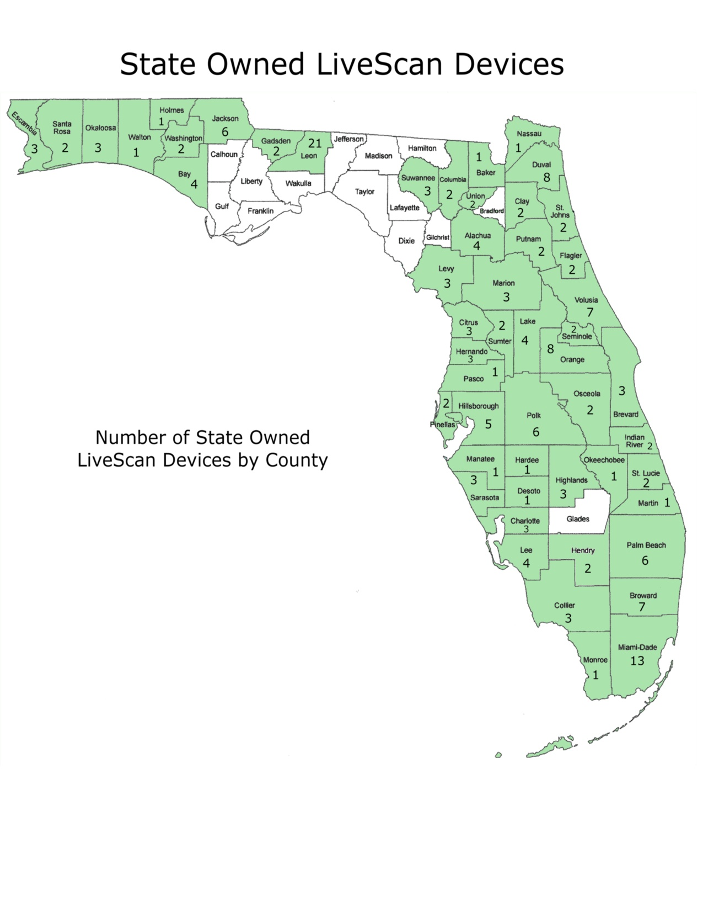
# State-Owned Devices by county
Notes:
Shows the # of devices owned by county and gives you an idea of how devices are spread geographically throughout the state.
As you can see, currently there are 21 Livescan devices in Leon county and none in several of the counties surrounding it.

Slide 18
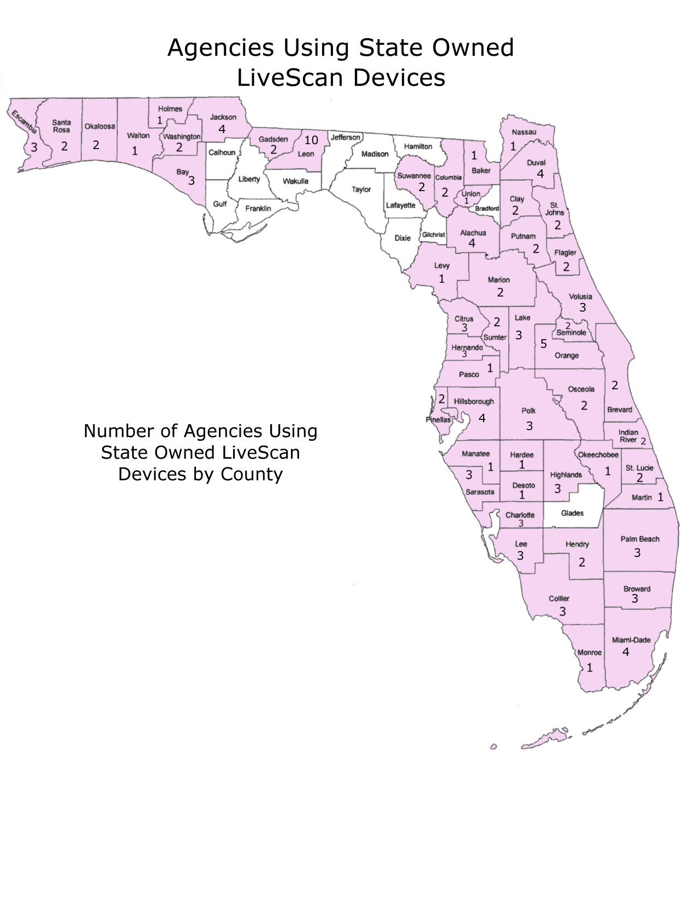
# Agencies using their own devices
Notes:
Shows the # of agencies using their own devices by county.

Slide 19
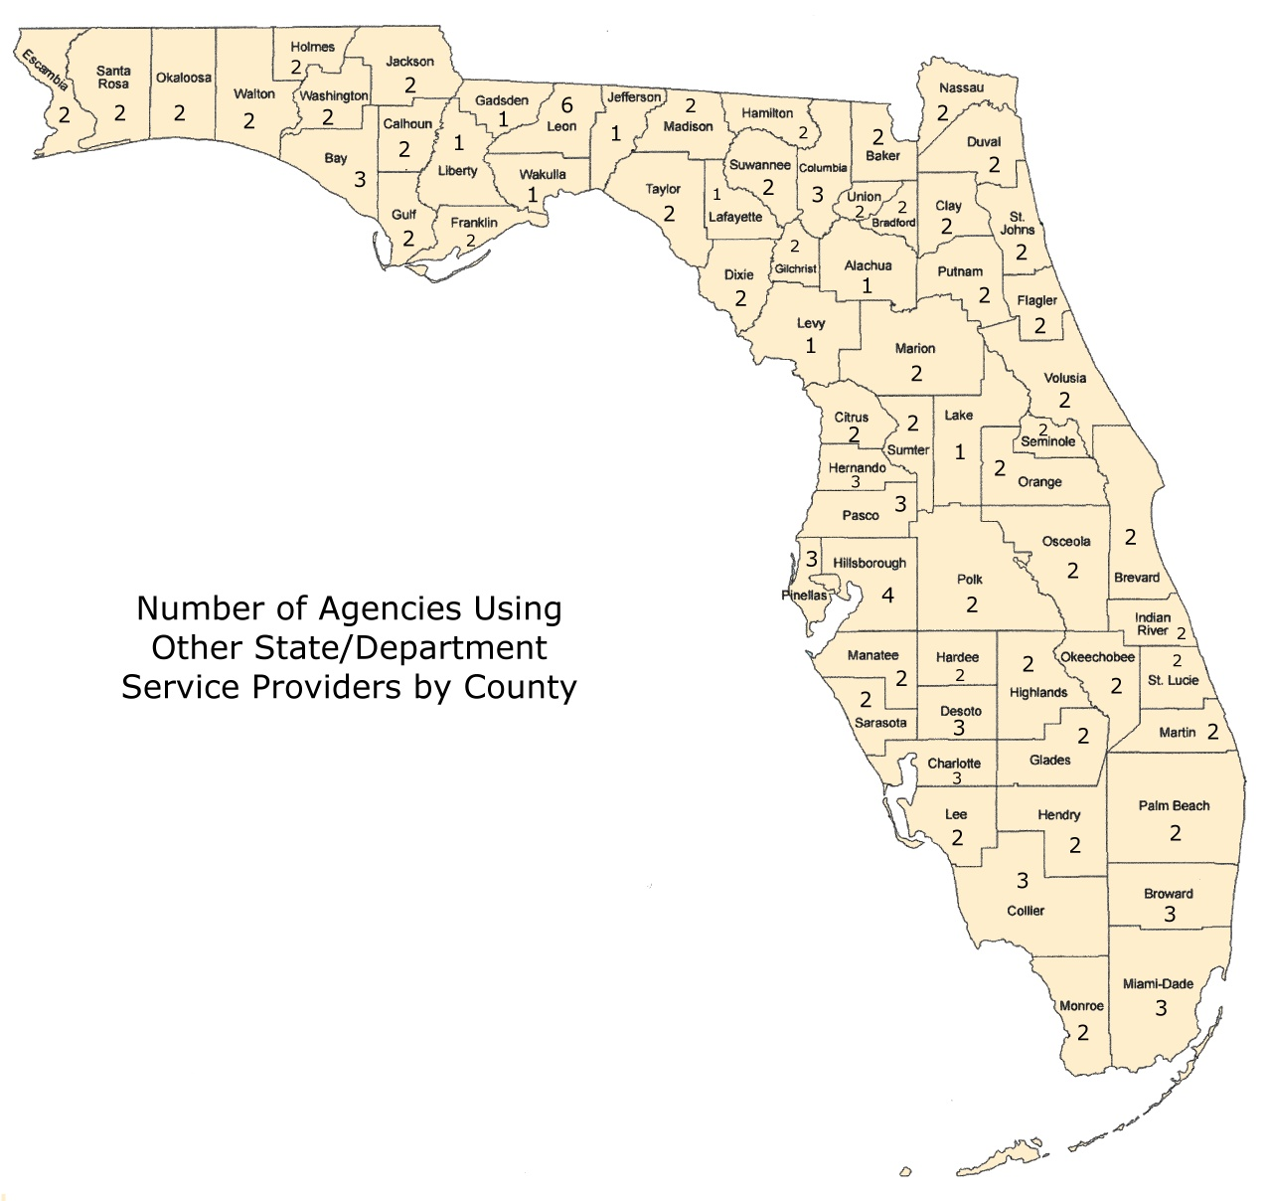
# agencies using other agency devices
Notes:
Shows the # of agencies using another state agency for fingerprinting.
As you can see, at least 1 agency in every county uses another agency.
For the counties that do not have a device (noted in first map), this map indicates that the agency has their employee travel to another county to be fingerprinted. For example Wakulla county.

Slide 20
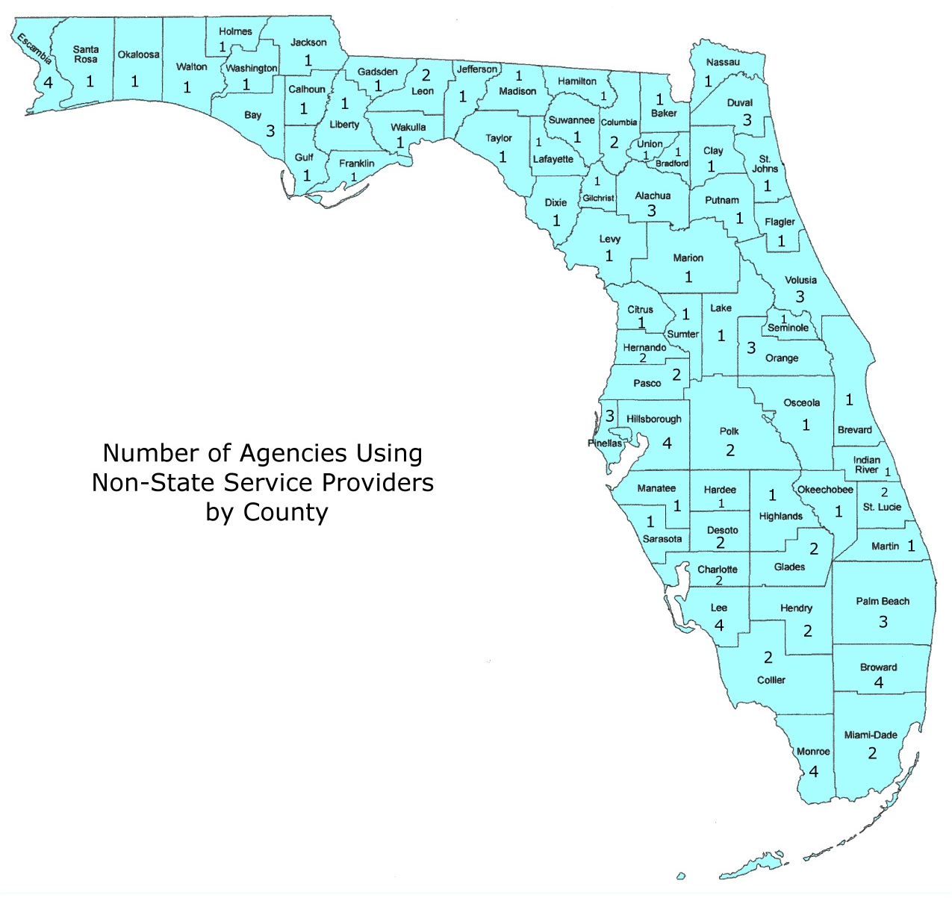
# Agencies using other Government Entity devices
Notes:
Shows the # of agencies using other government entities for fingerprinting (city, or county government or law enforcement).
As you can see, at least 1 agency in every county uses another government entity for fingerprinting.

Slide 21
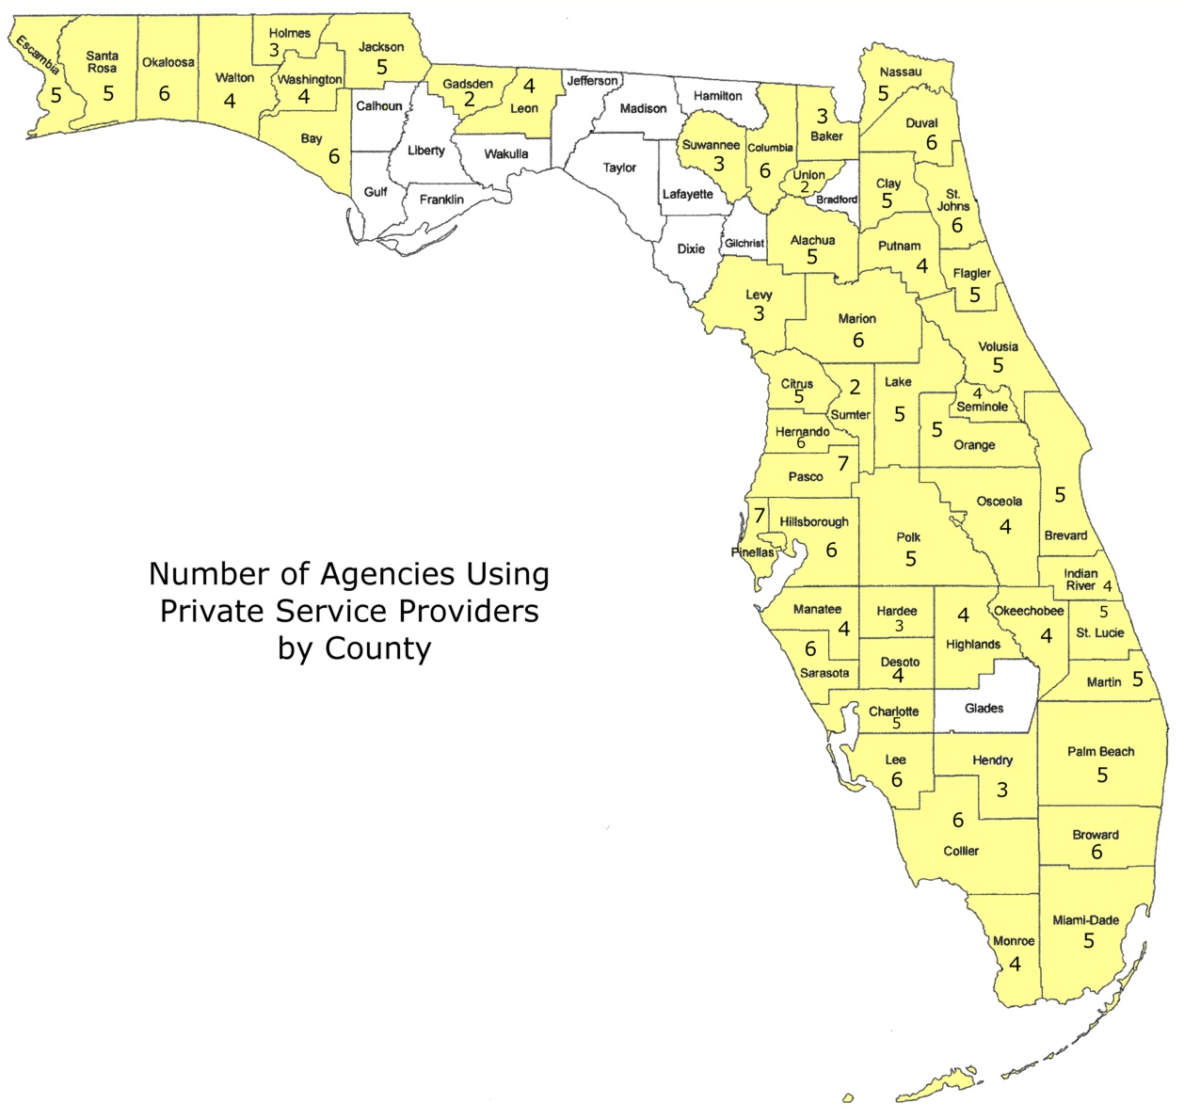
# agencies using private service providers
Notes:
Shows the # of agencies using private providers for fingerprinting.
If you compare it with the first and second map you see that although for Leon county there are 10 agencies that own a total of 21 devices, 4 agencies are still using private providers for fingerprinting.
Also noted in the survey was one agency stated they use a private service provider in two counties where the agency itself owns a device.

Slide 22
Memo of understanding/agreement
8 agencies report leveraging other agency devices for fingerprint and transmission services:
  6 agencies report having MOUs/MOAs in all instances;
  1 agency reports having MOUs/MOAs in some instances; and
  1 agency reports they do not have MOUs/MOAs with the two agencies used for fingerprinting services.
6 agencies report using non-state governmental entities for fingerprint and transmission services:
  Only one agency reports having an MOU/MOA.
Notes:
See presentation attachments for examples of MOUs/MOAs that state agencies have executed for background screening services.

Slide 23
COSTS TO PURCHASE AND MAINTAIN

Slide 24
INTIAL PURCHASE AND ONGOING MAINTENANCE
The cost to purchase a device ranges from approximately $14,000 to $18,000.
Additional items (e.g. extra scanners, hand held devices, etc.) can increase these initial costs.
Maintenance is included for two years.
After two years, annual maintenance agreements are available from the state-term contract vendor.
The typical maintenance cost is $1,620 per year.
  The costs listed above do not include the additional hardware (desktop/laptop/monitors) and other associated equipment that may be needed to operate the device.

Slide 25
Cost benefit analysis
  The following would provide justification to purchase new equipment when leveraging state and non-state service providers is not feasible:
  Formula to Purchase New Equipment:
  Equipment Cost + (Annual Maintenance * Life of the Equipment) = Annual Cost
  Life of the Equipment
  Formula to Use a Service Provider:
Average Number of Prints per year * Provider Fee = Annual Cost
Lower Cost of the Two Formulas Would Determine Purchase Vs. Outsource (less other required circumstances)
  NOTE: Formulas do not consider position allocation or salary costs into consideration.

Slide 26
PROS AND CONS

Slide 27
Agencies using their own devices
PROS and CONS
When determining whether an agency should continue to own and/or purchase devices, the following should be considered:
Pros
  Agency already invested in devices
  No additional acquisition cost is involved for providing services
  Fingerprinting can be scheduled at the convenience of the agency
  Decreased risk of personal/protected information misuse
Cons
  Travel expenses when device(s) are dispersed geographically
  Personnel support demands and expenses should be considered
  Cost of purchasing devices if not already owned
  Ongoing maintenance costs
  Federal retention participation may lessen the quantity/volume of fingerprint screenings, resulting in a need for fewer devices than currently owned

Slide 28
Leveraging state-owned devices
(different agencies)
PROS AND CONS
When leveraging state-owned devices, the following should be considered:
Pros
  Cost savings compared to using a private service provider
  Utilizing existing state owned equipment reduces the need to purchase new equipment
  Ease of accessibility due to the number of available devices throughout the state
Cons
  Increased demand on limited state personnel/resources (time and expense) for agencies offering the service
  Time and effort to establish a Memo of Understanding/Agreement that includes invoicing/payment agreement between agency and transmitting entity
  Increased possibility of transmittal errors to FDLE due to requirement to change originating (ORI) code for each requesting agency

Slide 29
Leveraging non-state governmental devices
PROS AND CONS
When leveraging non-state devices, the following should be considered:
Pros
  Ease of accessibility due to the number of available locations throughout the state
  Generally a trusted outside entity
  Generally a cost savings compared to private service providers
Cons
  Additional service fees
  Increased possibility of transmittal errors to FDLE due to requirement to change originating (ORI) code for each requesting agency
  Increased demand on non-state governmental personnel/resources (time and expense) offering the service
  Time and effort to establish a Memo of Understanding/Agreement that includes invoicing/payment agreement between agency and transmitting entity
Notes:
Authority does not exist that requires law enforcement agencies or criminal justice agencies to own a device.

Slide 30
Private Service providers
PROS AND CONS
When determining whether to use a private service provider, the following should be considered:
Pros
  Ease of accessibility due to the number of available private service providers throughout the counties
  Competitive pricing due to increased use of services
Cons
  Additional service fees
    A state term contract for fingerprinting services may help to lower private service fees.
  Time and effort to establish a contract that includes invoicing/payment agreement between agency and transmitting entity
Notes:
An increase in the utilization of private service providers by the State of Florida could create competition and result in more competitive fees (e.g. lower costs).

Slide 31
FINGERPRINT RETENTION

Slide 32
WHAT IS state Fingerprint retention?
Currently, FDLE stores the fingerprints of all persons undergoing employment background screening for agencies that participate in the Applicant Fingerprint Retention and Notification Program (AFRNP). This storing process is commonly referred to as fingerprint retention.
24 agencies reported via survey:
  8 are required to retain (free/required for sworn criminal justice personnel)
  1 voluntarily retains (option for a fee)
  15 do not retain
Meanwhile, FDLE reports the following state agencies currently retain fingerprints for state employment that are not required by law and do not fall under the category of a criminal justice agency:
  Executive Office of the Governor
  Department of Elder Affairs
  Northwood Shared Resource Center
  Southwood Shared Resource Center
Notes:
Retention is applied for entities applying for state licenses and other regulatory functions.

Slide 33
AFRNP fees
State retention is currently mandated for all sworn Criminal Justice personnel at no cost.
However, agencies may enroll other personnel:
  The State retention program requires a fingerprint based check upon enrollment (criminal history fee + any applicable service provider fees).
  Furthermore, the FDLE fee to retain fingerprints is $6.00 per transaction per year.
    However, the first year of retention is included in the cost.
Notes:
The fingerprint based submission may be a Level 1 screening.
10 of 24 agencies rescreen employees using Level 2 procedures every five years. Background screening fees vary for agencies that do not retain fingerprints. Based on survey results, screening costs range from $40.50-$68.00 per person (p.p.) for those who rescreen using Level 2 every five years.

Slide 34
AFRNP benefits
FDLE notifies agency of new state arrests.
Continual employee state arrest search improves accountability and public safety.
Administrative duties will be reduced. For example there will no longer be a need to:
  Manually track new arrests
  Obtain fingerprints for periodic rescreening/renewal
Level 2 rescreening is for a lesser fee of $16.50 and is initiated via an FDLE database solution (FALCON).

Slide 35
Risks of not participating in afrnp
Crimes committed between periodic employee background rescreening may remain undisclosed.
Dependence on employees to report a new arrest.
Risk of negative affects resulting from incidents involving employees who should have been terminated for a new arrest.
Public scrutiny, unfavorable media attention, or law suits for continuing to employ individuals who were arrested for certain offenses.

Slide 36
Coming soon: Federal retention
Florida is planning to participate in the FBI’s national retention program called the Next Generation Identification (NGI) Rap Back Program.
FBI’s implementation of the NGI Rap Back program is slated for August 2014. FDLE is beginning their preparations to support this program as information is released.
The NGI Rap Back program will provide more assurances than the AFRNP by notifying employers of certain federal arrests, as well as, all state arrests nationwide that result in fingerprint bookings.
Notes:
All tiers, regardless of term, require periodic validation that the subject of enrollment still maintains a position of trust. Failure to validate will result in the termination of the subject’s enrollment.

Slide 37
NGI rap back program fees
On July 29, 2013 the FBI released the interim fee schedule:
  Tier 1 ($2.25) requires renewal of enrollment and payment of a new fee no later than two years from the original enrollment date;
  Tier II ($6.00) requires renewal of the enrollment and payment of a new fee no later than five years from the original enrollment date;
  Tier III ($13.00) requires neither “renewal” of enrollment nor payment of a new fee to receive service continuously. Refers to the period during which the individual holds a position of trust within the same state agency.
    This does not include the criminal history fees for a Level 2 screening required upon enrollment.
Notes:
Tiers available to State of Florida agencies is subject to change as preparation for implementation progresses.

Slide 38
State vs. federal retention
If an agency is currently not participating in AFRNP and is considering the overall benefits of retention… it would be prudent to begin the transition to retention once the NGI Rap Back Program is fully implemented and integrated within FDLE’s infrastructure.
This is due to the following considerations:
Both the State and Federal retention programs require a Level 2 screening upon enrollment (criminal history fees + applicable service provider fees if applicable).
  State retention still requires a Level 2 rescreening upon the frequency mandated in applicable agency internal policies.
  Federal retention eliminates the necessity to rescreen as long as the personnel remains in a sensitive position within the same state agency.
  Overall, the NGI Rap Back Program will provide more benefit at less cost.

Slide 39
RECOMMENDATIONS

Slide 40
Economic efficiency Recommendations
The State should re-evaluate current needs for background screening employees in light of the various options available. What has taken place historically may no longer be the most feasible option.
Some agency factors to consider include:
Where feasible, leverage state and non-state service providers to contain costs.
If leveraging devices is not feasible, each agency should perform a cost benefit analysis prior to purchasing new equipment.
Some State considerations include:
Determining which of the following will best help to contain costs:
  Implement a state term contract for either regional or state-wide private service providers.
  Utilizing more private service providers to encourage competition.
Notes:
Some agencies have contracts with a private service provider to lock-in fees as low as $11.00 per transaction.

Slide 41
Administrative Efficiency and accountability recommendations
Agencies should consider their current expenditures for background screening in conjunction with the fees and additional benefits provided by the FBI’s NGI Rap Back Program and determine if the value justifies the cost.
Considerations include:
  The risks of not retaining can leave the employer vulnerable and unaware of new employee arrests.
  Whereas, the benefits protects the employer, vulnerable populations , property, and the public.
  Benefits are especially applicable in agencies where Level 2 rescreening is desired, but not fiscally practical.
  Multi-state criminal history reports will be available once the FBI NGI Rap Back Program is fully integrated within FDLE’s infrastructure in the near future.

Slide 42
Project Team
Michael J. Bennett (DOH)
Michelle L. Weaver (DOH)
Kim Rolfe (DOH)
Lourdes Howell-Thomas (FDLE)
Helene Muth (DJJ)
Myra Burks (DJJ)
David Ulewicz (DHSMV)
Megan Frink (DHSMV)
Sally Moniz (DOC)
Vanessa Williams (DOC)
Tabitha McNulty (DOEA)
Sarah Beth Hall (DOL)
Kathy Sullivan (DMS)
Special thanks to:
  Donna Uzzell (FDLE)
  Timothy Giesecke (FDLE)
  Chris Johnson (FDLE)
  Martha Wright (FDLE)

Slide 43
Project survey Participants
Business and Professional Regulation
Children and Families
Corrections
Early Learning
Economic Opportunity
Education
Elder Affairs
Emergency Management
Environmental Protection
Executive Office of the Governor
Fish & Wildlife Conservation Commission
Florida Lottery
Health
Health Care Administration
Highway Safety and Motor Vehicles
Juvenile Justice
Law Enforcement
Management Services
Military Affairs
Persons with Disabilities
Revenue
State
Transportation
Veterans' Affairs
Thank you to the following agencies for participating in the project survey:

Slide 44
Moving Forward
This presentation along with the attachments will be distributed to all Inspectors General and Directors of Auditing.
Please share the information with the appropriate entity/entities within your Agency who are responsible for background screening.
At a minimum we encourage Offices of Inspectors General to meet with their agency head and key individuals to review these results and discuss methods for re-evaluating their current processes in light of the information provided.
  If you would like to request a copy of your agency’s individual survey responses, please contact the team lead or assistant team lead.

